Slide 1
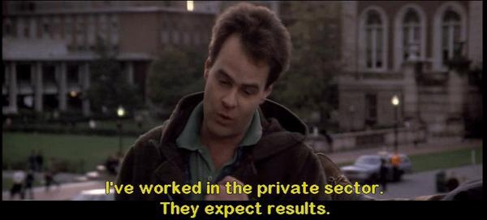
Archiving Deferred Representations Using a Two-Tiered Crawling Approach
Justin F. Brunelle, Michele C. Weigle, Michael L. Nelson Old Dominion University iPRES2015, UNC Chapel Hill, NC USA
November 3, 2015
http://arxiv.org/abs/1508.02315

Slide 2
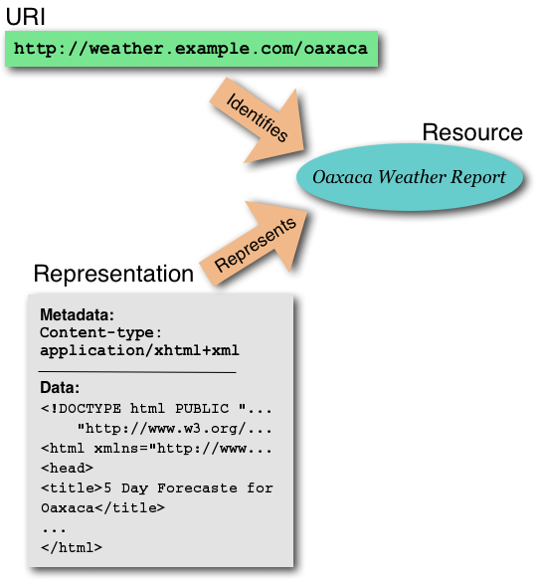
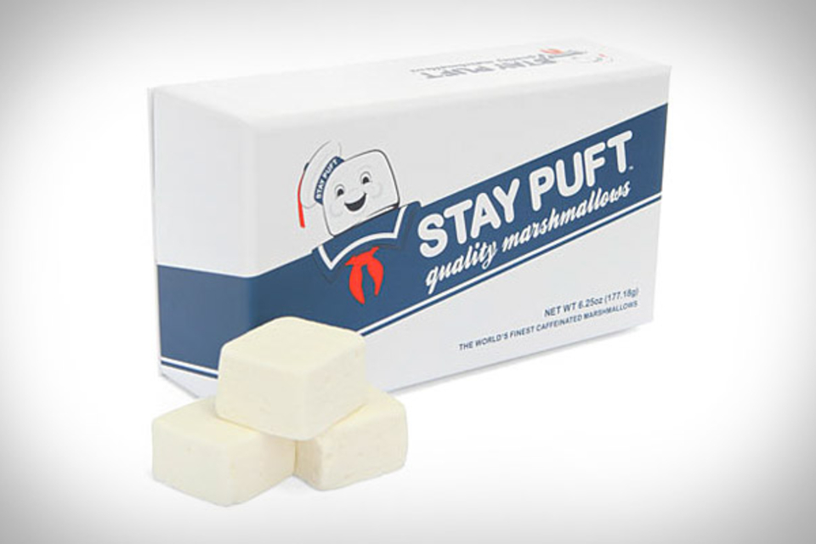
A simpler time...

Slide 3
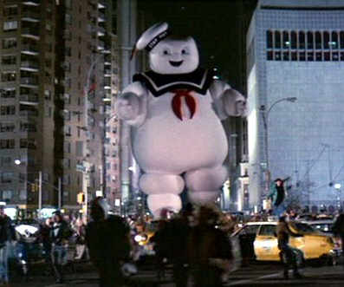
Mass hysteria. Human sacrifices. Dogs and cats living together.
<iframe><script>...</script></iframe>

Slide 4
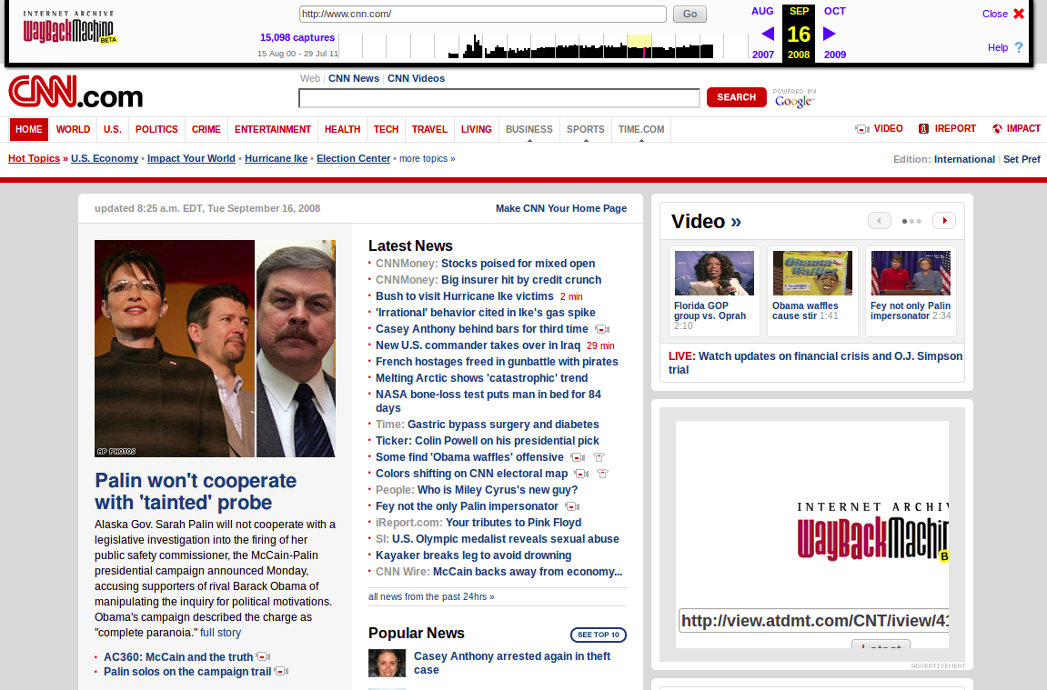
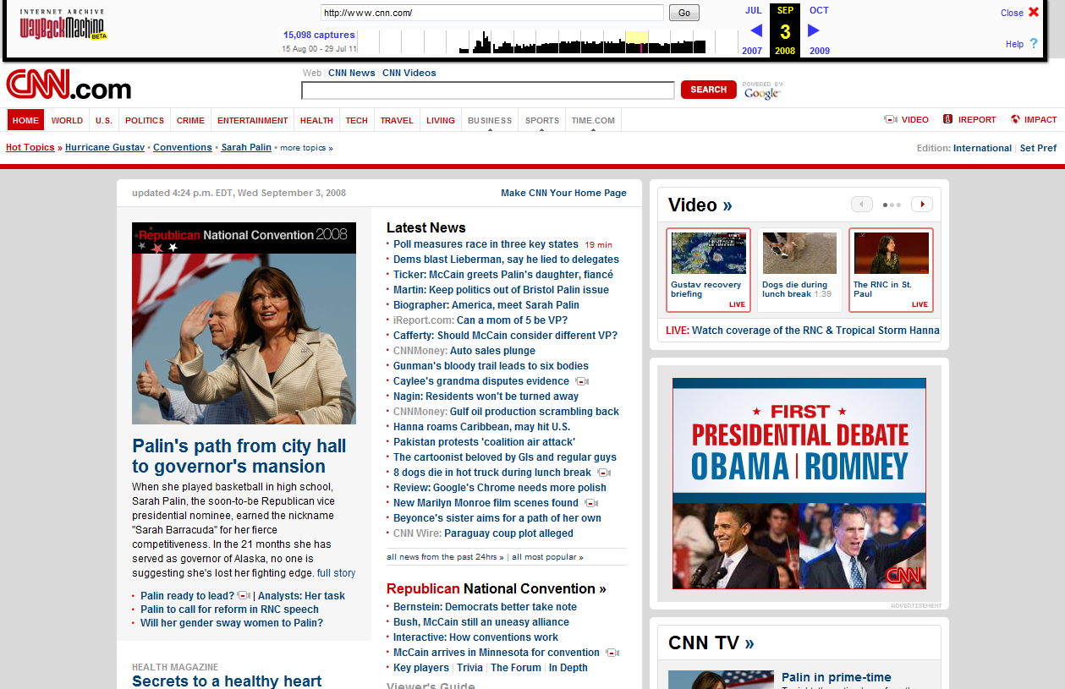
Missing resources (bad) and Temporal violations (worse)
2008
2012
http://ws-dl.blogspot.com/2012/10/2012-10-10-zombies-in-archives.html
4

Slide 5
JavaScript is hard to replay
What happens when an event is completely lost?
http://ws-dl.blogspot.com/2013/11/2013-11-28-replaying-sopa-protest.html
5

Slide 6
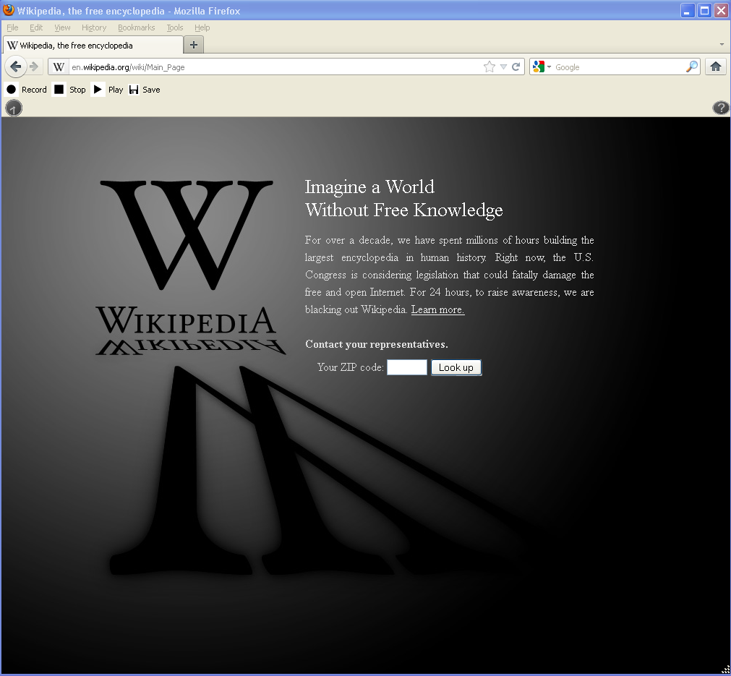
http://en.wikipedia.org/wiki/Main_Page January 18th, 2012
6
Notes:
Wikipedia protest is important because it represents the internet dissent over the legislation. This is a snapshot of wikipedia on january 18th, 2012.

Slide 7
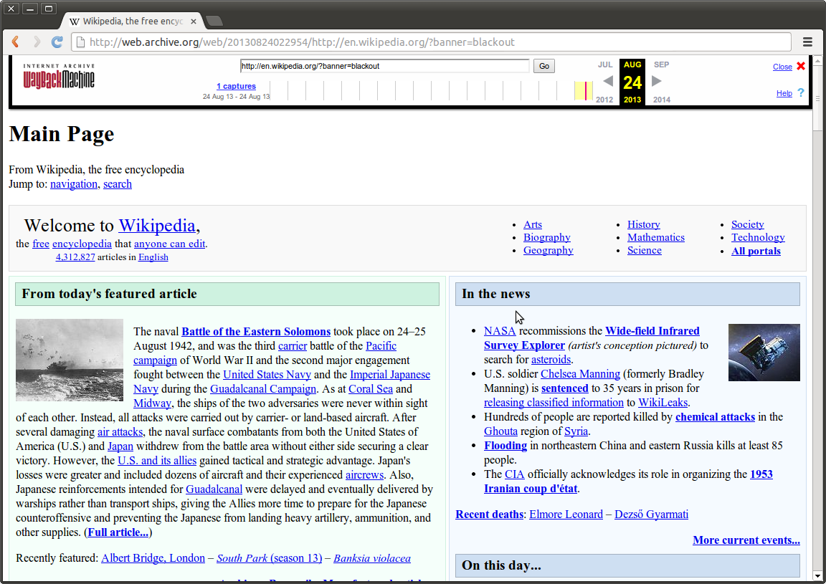
http://web.archive.org/web/20120118110520/http://en.wikipedia.org/wiki/Main_Page
January 18th, 2012
7
Notes:
At the time, the Internet Archive had a 60-month quarantine for their archived pages. We had to wait 6 months before discovering that the Internet Archive did not capture the splash page, either.

Slide 8
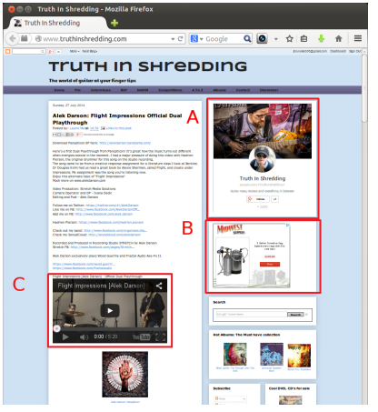
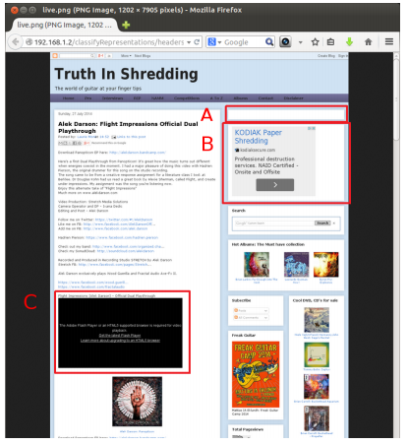
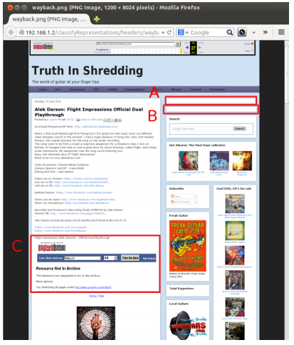
Not all tools can crawl equally
Live Resource
PhantomJS Crawled
Heritrix Crawled, Wayback replayed
8

Slide 9
Not all tools can crawl equally
Live: JavaScript PhantomJS: JavaScript Heritrix: No JavaScript
Live Resource
PhantomJS Crawled
Heritrix Crawled, Wayback replayed
9

Slide 10
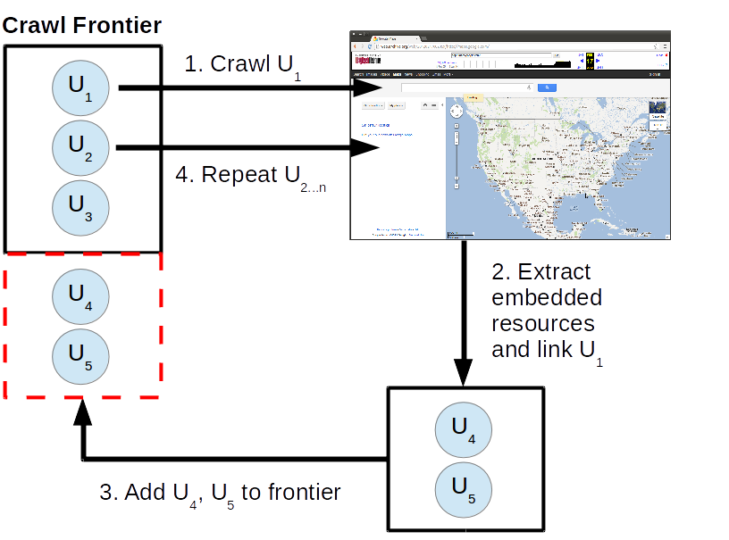
Current
Workflow
Dereference URI-Rs
Archive
representation
Extract embedded
URI-Rs
Repeat
10

Slide 11
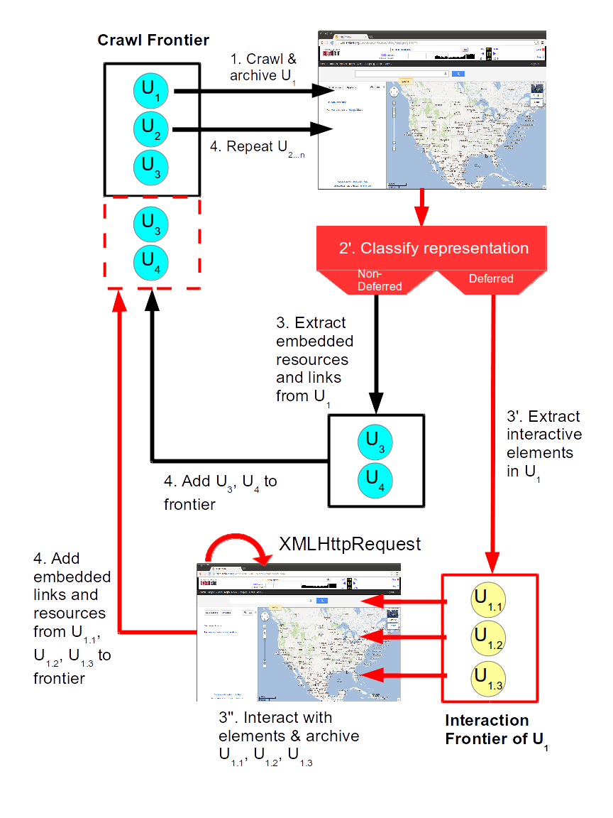
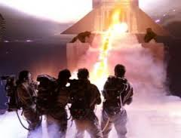
Proposed Workflow
11

Slide 12
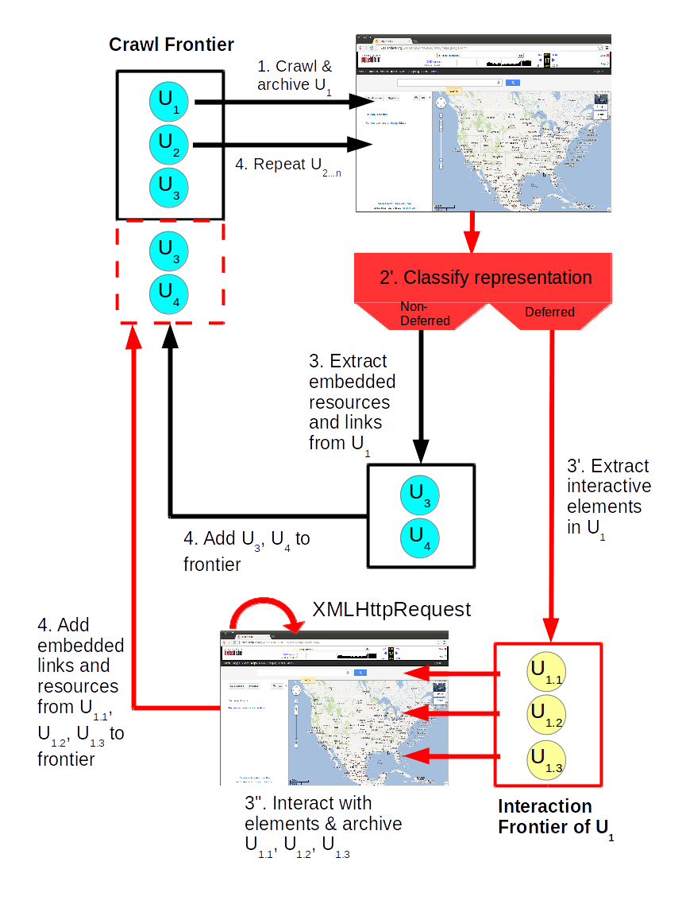
Current workflow not suitable for deferred representations
<script> tags alone are not indicative of a deferred representation. JavaScript can be played back in the archives!
Two-tiered crawling approach to optimize performance
Use PhantomJS to run JavaScript, interact with the representation
12

Slide 13
Current workflow not suitable for deferred representations
More URI-Rs in the crawl frontier
<script> tags alone are not indicative of a deferred representation. JavaScript can be played back in the archives!
Two-tiered crawling approach to optimize performance
Use PhantomJS to run JavaScript, interact with the representation
Runs more slowly but more deeply
13

Slide 14
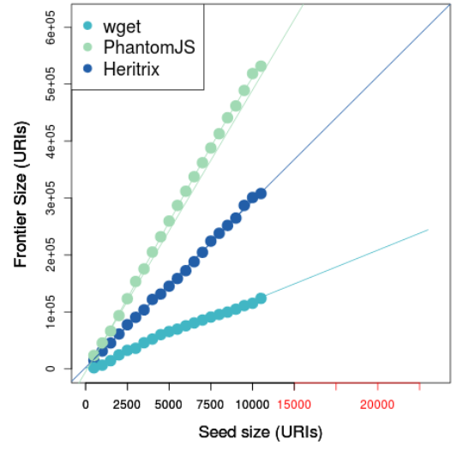
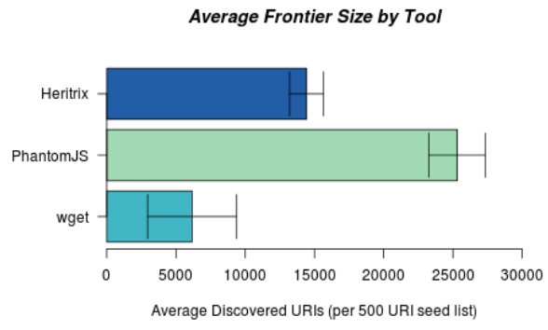
The Good: Frontier size PhantomJS vs. Heritrix
PhantomJS frontier is 1.5 times larger than Heritrix
14

Slide 15
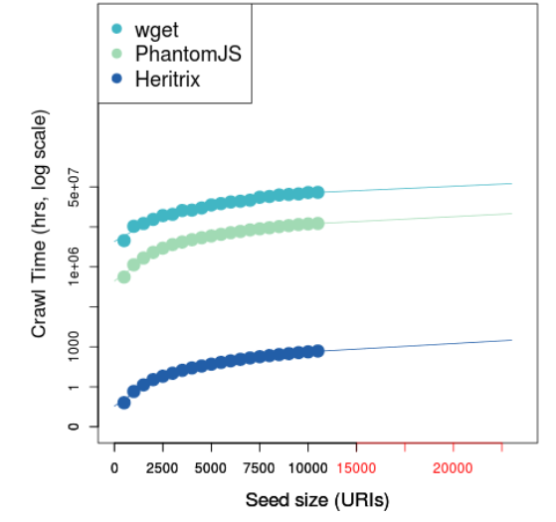
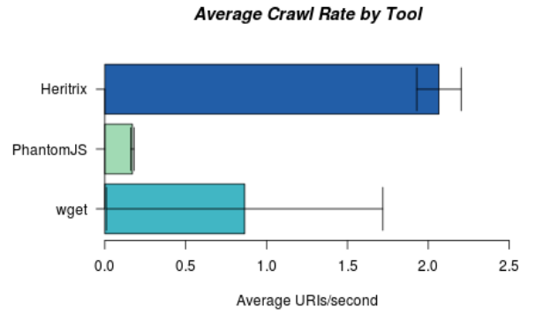
The Bad: Run-time PhantomJS vs. Heritrix
PhantomJS crawl speed is 10.5 times slower than Heritrix
15

Slide 16
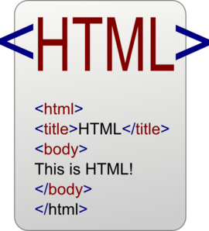




JavaScript != Deferred
Deferred
Nondeferred
Deferred at s₀
Deferred on interaction
Nondeferred; with interaction
Nondeferred
HTTP GET
HTTP GET
HTTP GET
HTTP GET
onload
16
Notes:
<number>

Slide 17
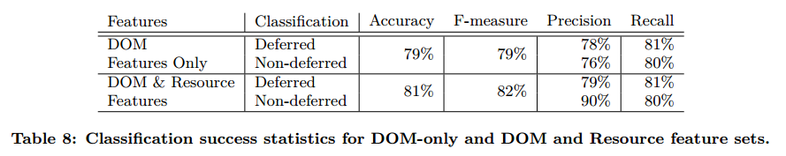
Classifier accuracy improved slightly when monitoring HTTP requests
17

Slide 18
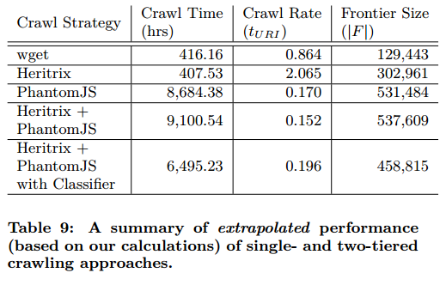
Performance metrics of a two-tiered crawling approach
18

Slide 19
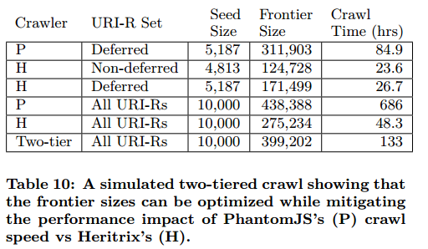
The classifier helps crawl deferred representations most efficiently
19

Slide 20

JavaScript interaction trees are only 2 deep
s₀
s₁
s₂
http://www.bloomberg.com/bw/articles/2014-06-16/open-plan-offices-for-people-who-hate-open-plan-offices
20

Slide 21


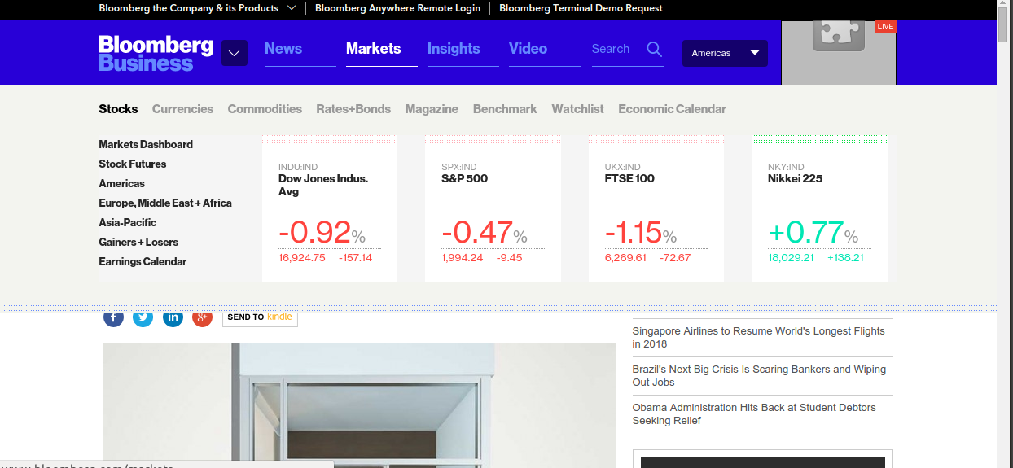
JavaScript interaction trees are only 2 deep
s₀
mouseOver
s₁
s₂
http://www.bloomberg.com/bw/articles/2014-06-16/open-plan-offices-for-people-who-hate-open-plan-offices
21

Slide 22

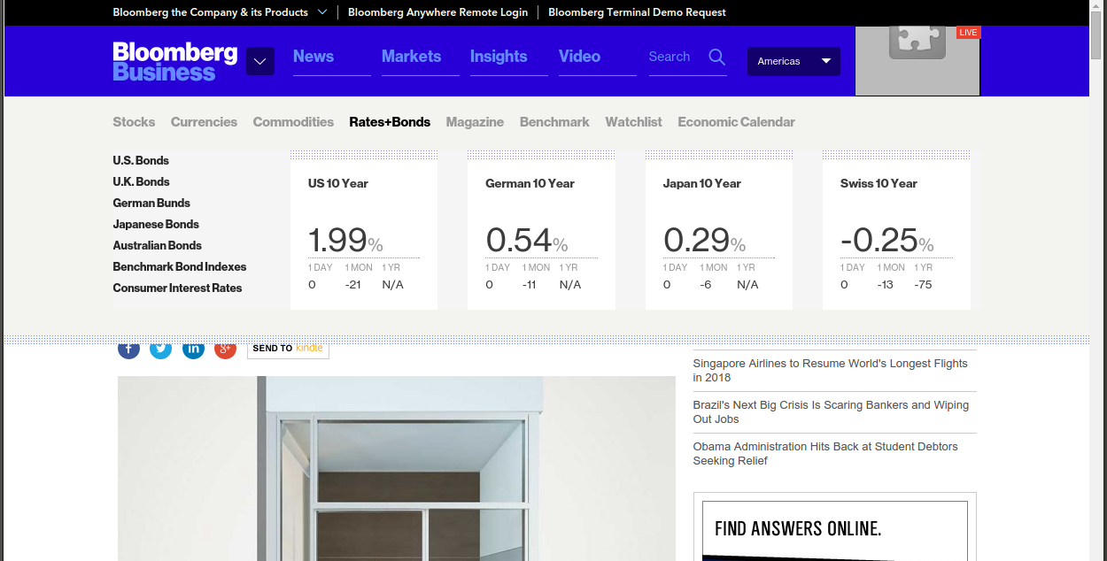
JavaScript interaction trees are only 2 deep
s₀
mouseOver
s₁
mouseOver
s₂
http://www.bloomberg.com/bw/articles/2014-06-16/open-plan-offices-for-people-who-hate-open-plan-offices
22

Slide 23
JavaScript interaction trees are only 2 deep
s₀
mouseOver
s₁
mouseOver
s₂
http://www.bloomberg.com/bw/articles/2014-06-16/open-plan-offices-for-people-who-hate-open-plan-offices
23

Slide 24

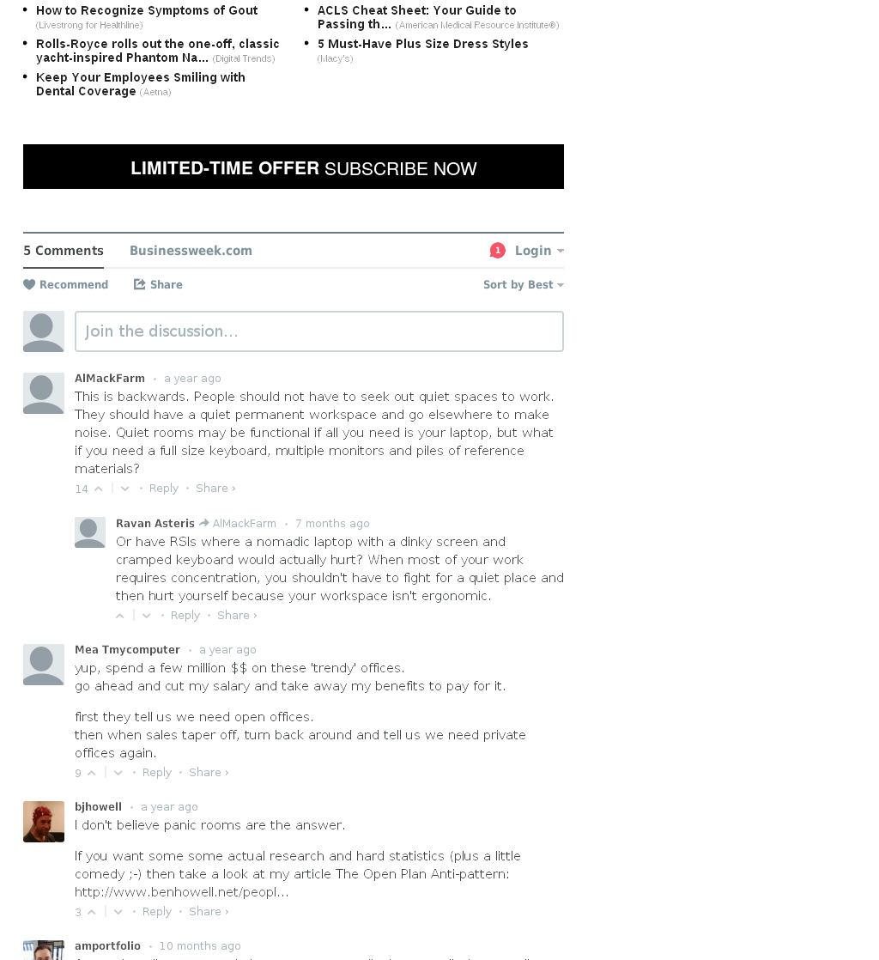
JavaScript interaction trees are only 2 deep
s₀
mouseOver
click
click
s₁
mouseOver
s₂
http://www.bloomberg.com/bw/articles/2014-06-16/open-plan-offices-for-people-who-hate-open-plan-offices
24

Slide 25
Storage Size Impact
JSON MetaData of interactions, resulting descendants
16.5KB WARC MetaData
143MB for total dataset
11.4 times larger for deferred vs nondeferred
Totals 5.12 times more storage per URI-R for total dataset
25
Notes:
<number>

Slide 26
Current & Future Work
Using PhantomJS to execute actions on the client
Pushing buttons
Selecting drop-downs
Archiving resulting representation changes
Represent representation state in WARCs
Graph structure of embedded resources
Replay in the Wayback Machine
http://ws-dl.blogspot.com/2015/06/2015-06-26-phantomjsvisualevent-or.html
26
Notes:
<number>

Slide 27
Conclusions
Proposed two-tiered crawling approach with classifier
Mitigates impacts of JavaScript on archives
10.5 times slower than Heritrix-only
1.5 times larger crawl frontier than Heritrix only
5.12 times more storage
Next steps: interaction frontiers, forms, archival replay
Additional resources:
URI Dataset: http://www.cs.odu.edu/~jbrunelle/wsdl/10kuris.txt
Technical report: http://arxiv.org/pdf/1508.02315v1.pdf
Code: https://github.com/jbrunelle/classifyDeferred
27
Notes:
<number>

Slide 28
Backups

Slide 29
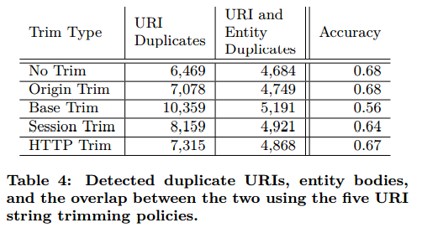

Slide 30
Data and metrics
Random Bitly strings: http://bit.ly/1mcCVqp
URIs/sec, frontier:
Heritrix: Crawler User Interface
PhsntomJS and wget: unix time and crawl logs
Notes:
<number>

Slide 31
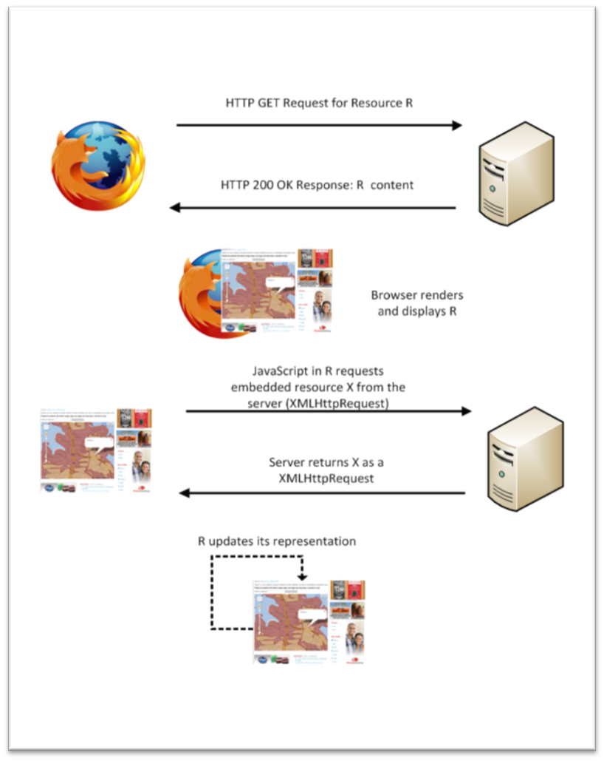
Web Browsing Process
User-controlled
Interaction
Environment variables
<number>
Notes:
<number>

Slide 32
Web Browsing Process
At any given time, users get “a” representation.
There is no longer “the” representation that archives target.
<number>
Notes:
<number>

